Slide 1

CHAPTER 3:
GRAPHICS PRIMITIVES

Slide 2
OUTLINES
In this chapter, we’ll have a look at:
  DDA (Digital Differential Analyzer)
  Bresenham’s line drawing algorithm
  Circle drawing algorithms
    A simple technique
    The mid-point circle algorithm
  Polygon fill algorithms
  Summary of raster drawing algorithms

Slide 3
SCAN CONVERSION
Definition
It is the responsibility of the graphics system or the application program to convert each primitive from its geometric definition into a set of pixels that make up the primitive in image space. This conversion task is generally referred to as Scan Conversion / Rasterization.

Slide 4
DEFINITION
Many pictures from 2D drawing to projected views of 3D objects consist of graphical primitives such as lines, points, circles and filled polygons.
These picture components are often defined in continuous space at a higher level of abstraction than individual pixels in the discrete image space.
For instance, a line is defined by 2 end points and its line equation, where as a circle is defined by its radius center position and the circle equation.

Slide 5
GRAPHICS OUTPUT PRIMITIVES
Primitives: functions in graphics package that we use to describe picture element
Points and straight lines are the simplest primitives
Some packages include circles, conic sections, quadric surfaces, spline curves and surfaces, and polygon color area

Slide 6
2D CARTESIAN REFERENCE SYSTEM
y
x
y
x
Coordinate origin at the
lower-left screen corner
Coordinate origin in the
upper-left screen corner

Slide 7
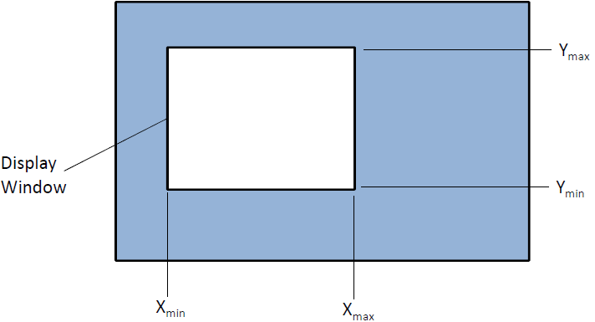
TWO-DIMENSIONAL WORLD COORDINATE REFERENCE FRAME IN OPENGL
glMatrixMode (GL_PROJECTION);
glLoadIdentity ();
gluOrtho2D (xmin, xmax, ymin, ymax);

Slide 8
OPENGL POINT FUNCTIONS
glVertex* ( ): OpenGL function to state coordinates values for point, where (*) suffix code required
glBegin (GL_POINTS);
glVertex* ( );
glEnd ();
Coordinates (x,y,z)
* represents suffix codes
1st – 2,3,4 (dimensionality of a coordinate position)
2nd – data type (i, s, f, d)
3rd – if array specification is used – v
Note: A glVertex must be placed glBegin( ); and glEnd( );

Slide 9
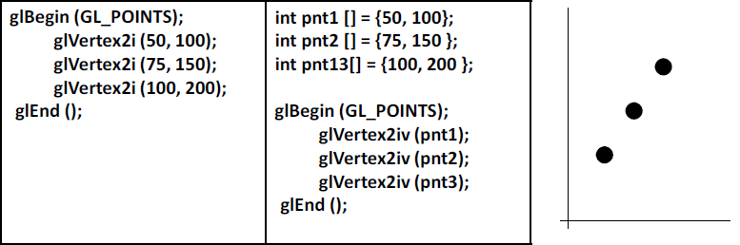
Example - glVertex*( )

Slide 10
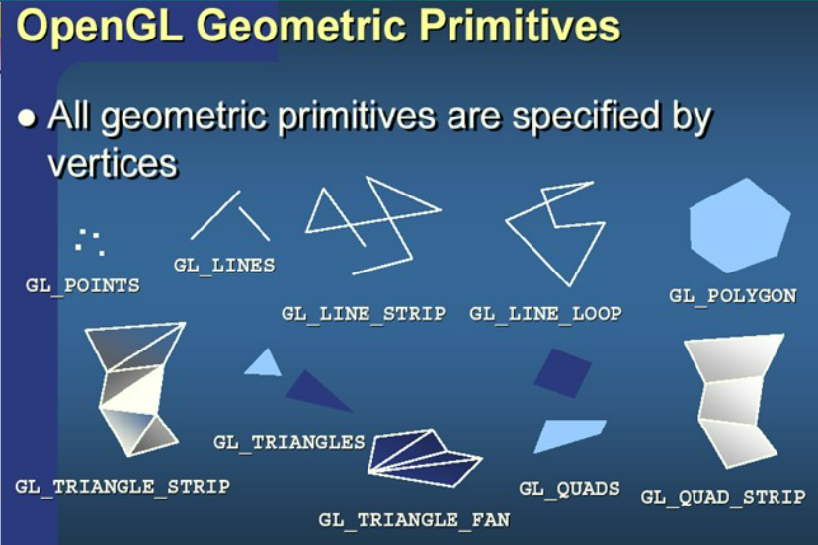
OPENGL OUTPUT PRIMITIVES

Slide 11
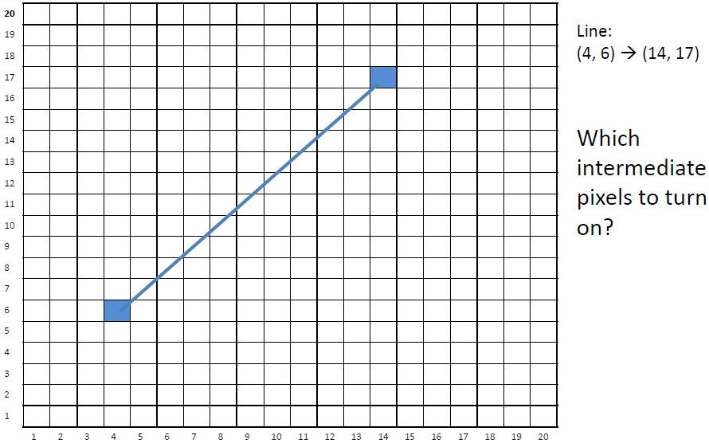
LINE DRAWING ALGORITHMS
Programmer specifies (x, y) values of end pixels
Need algorithm to figure out which intermediate pixels are on line path
glBegin (GL_LINES);
glVertex2iv (4,6 );
glVertex2iv (14,17 );
glEnd ();

Slide 12
LINE DRAWING ALGORITHMS
Pixel (x, y) values constrained to integer values
Actual computed intermediate line values may be floats→ Rounding may be required.
e.g. computed point (10.48, 20.51) rounded to (10, 21)
Rounded pixel value is off actual line path (jaggy!!)
Sloped lines end up having jaggies
Vertical, horizontal lines, no jaggies

Slide 13
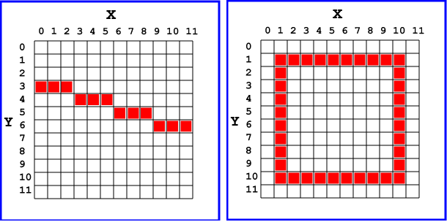
LINE DRAWING ALGORITHMS

Slide 14
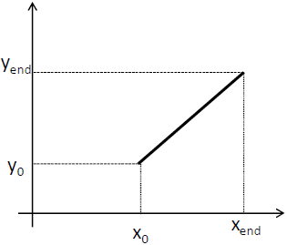
LINE DRAWING ALGORITHMS
Slope-intercept line equation
y = m . x + b ; (m: slope of the line,
b: the point where the line intercepts of y-axis)
Given two end points (x₁, y₁) and (x₂, y₂), how to compute m and b?
  m = ∆y / ∆x = (y2 - y1)/(x2 - x1)
  b = y1 – m . x1
Example:
Find the slope of (23, 41) and (125, 96)
m = (96 - 41) / (125 – 23) = 55 / 102
= 0.5392

Slide 15
LINE DRAWING ALGORITHMS
Line drawing algorithms
  DDA (Digital Differential Analyzer): is the simplest line drawing algorithm
Bresenham’s Line algorithm: more accurate, efficient (integer DDA) algorithm.

Slide 16
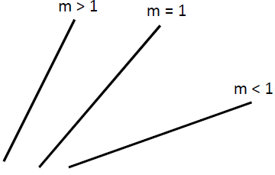
DDA (DIGITAL DIFFERENTIAL ANALYZER)
DDA is a scan-conversion line algorithm based on calculating either ∆y or ∆x
A line is sampled at unit intervals in one coordinates and the corresponding integer values nearest the line path are determined for the other coordinate
Case (m <= 1) : x is incrementing faster: step in x =1 increment, compute and round y value as y_{k+1} = y_{k} + m
Case (m > 1) : y is incrementing faster: step in y =1 increment, compute and round x as x_{k+1} = x_{k} + 1 / m

Slide 17
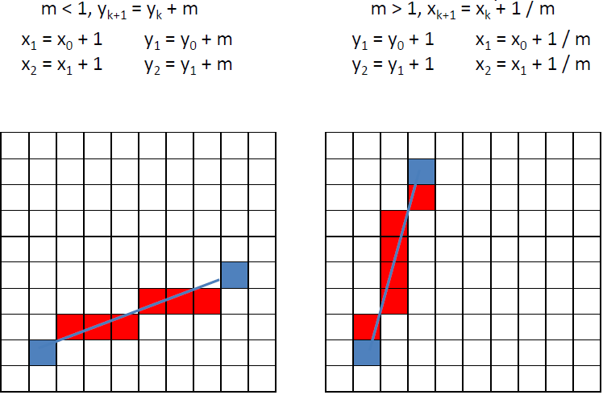
DDA (DIGITAL DIFFERENTIAL ANALYZER)

Slide 18
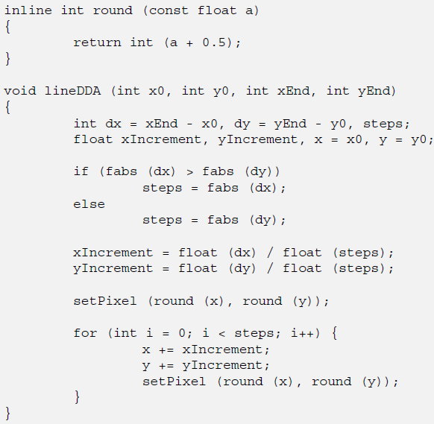
DDA (DIGITAL DIFFERENTIAL ANALYZER)

Slide 19
DDA (DIGITAL DIFFERENTIAL ANALYZER)
Positive Slope
  If drawing starts from
  left to right:
  if |m| ≤ 1, then
  x_{Inc} = 1, y_{Inc} = m
  if |m| > 1 for positive m, then
  x_{Inc} = 1/m, y_{Inc} = 1
  If drawing starts from
  right to left:
  if |m| ≤ 1, then
  x_{Inc}= -1, y_{Inc} = -m
  if |m| > 1 for positive m, then
  x_{Inc} =- 1/m, y_{Inc} = -1

Slide 20
DDA (DIGITAL DIFFERENTIAL ANALYZER)
Negative Slope
  If drawing starts from
  left to right:
  if |m| ≤ 1, then
  x_{Inc} = 1, y_{Inc} = m
  if |m| > 1 for negative m, then
  x_{Inc} = -1/m, y_{Inc} = -1
  If drawing starts from
  right to left:
  if |m| ≤ 1, then
  x_{Inc}= -1, y_{Inc} = -m
  if |m| > 1 for negative m, then
  x_{Inc} = 1/m, y_{Inc} = 1

Slide 21
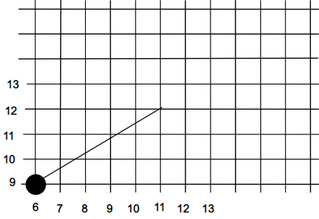
DDA EXAMPLE
Compute which pixels should be turned on to represent the line from (6,9) to (11,12).
Step = ?
xinc = ?
yinc = ?

Slide 22
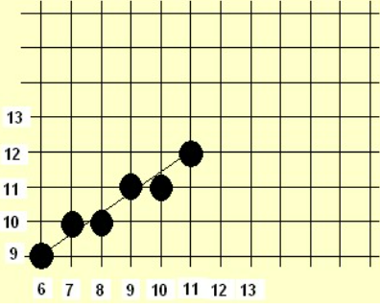
DDA EXAMPLE
Line from (6,9) to (11,12)
Step: Max of (ABS(11 – 6), ABS(12 – 9)) = 5
xinc = 1
yinc = 0.6
Values computer are:
(6,9)
(7,9.6)
(8,10.2)
(9,10.8)
(10,11.4)
(11,12)

Slide 23
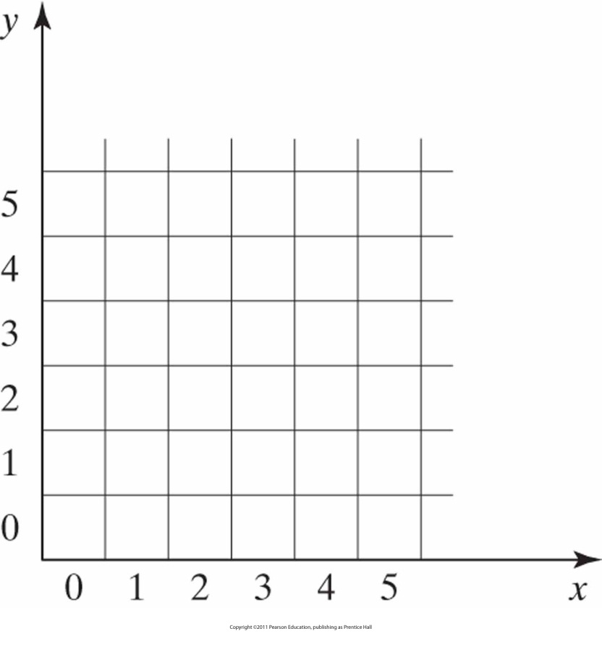
DDA EXAMPLE 1
Given the following endpoints of a line, find the line points that will be produced using DDA algorithm.
p₁(3,2), p₂(7,4)
p₁(2,3), p₂(4,7)
p₁(7,4), p₂(3,2)
p₁(4,7), p₂(2,3)
p₁(2,7), p₂(4,3)
p₁(4,3), p₂(2,7)

Slide 24
DDA EXAMPLE 2
Given the endpoints p₁(2,8), p₂(6,0) of a line, find the line points that will be produced using DDA algorithm.

Slide 25
DDA
Advantages:
  Faster than using y = mx + b
  Eliminates multiplication (mx) by using screen characteristics, i.e., incrementing pixel.
Disadvantages:
  Floating point arithmetic is slower than integer arithmetic.
  Rounding down takes time.
  Long lines can drift from the true line due to floating-point round-off errors.

Slide 26
BRESENHAM’S LINE DRAWING ALGORITHM
DDA:
Not very efficient
Round operation is expensive
Optimized algorithms typically used Bresenham’s algorithm ( Integer DDA)
Incremental algorithm: current value uses previous value
Integer calculation only: avoid floating point arithmetic
Several versions of algorithm (e.g., midpoint version)

Slide 27
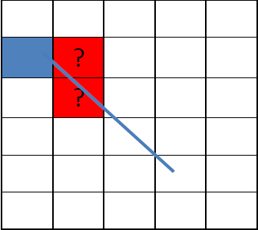
BRESENHAM’S LINE DRAWING ALGORITHM
The Bresenham algorithm is another incremental scan conversion algorithm.
Accurate, efficient, and uses only incremental integer calculations
Sampling at unit intervals, decide which of two possible pixel positions is closer to the line path
Move across the x axis in unit intervals and at each step choose between two different y coordinates.

Slide 28
BRESENHAM’S LINE DRAWING ALGORITHM
The Bresenham algorithm is another incremental scan conversion algorithm.
Accurate, efficient, and uses only incremental integer calculations
Sampling at unit intervals, decide which of two possible pixel positions is closer to the line path
Move across the x axis in unit intervals and at each step choose between two different y coordinates.

Slide 29
BRESENHAM’S LINE DRAWING ALGORITHM
5
(x_{k}+1, y_{k}+1)
For example, from position (2, 3) we have to choose between (3, 3) and (3, 4). We would like the point that is closer to the original line
4
(x_{k}, y_{k})
3
(x_{k}+1, y_{k})
2
2
3
4
5

Slide 30





BRESENHAM’S LINE DRAWING ALGORITHM
At sample position x_{k}+1 the vertical separations from the mathematical line are labelled d_{upper} and d_{lower.}
The y coordinate on the mathematical line at x_{k}+1 is:
So, d_{upper} and d_{lower} are given as follows:
y_{k+1}
d_{upper}
y
d_{lower}
y_{k}
x_{k}+1
We can use these to make a simple decision about which pixel is closer to the mathematical line.

Slide 31

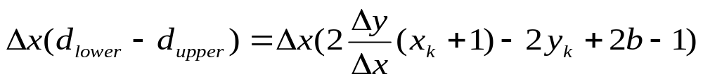


BRESENHAM’S LINE DRAWING ALGORITHM
This simple decision is based on the difference between the two pixel positions. If p_{k} is negative, then we choose the lower pixel, otherwise we choose the upper pixel
Let’s substitute m with ∆y/∆x where ∆x and ∆y are the differences between the end-points:
At step k+1 the decision parameter is given as:

Slide 32

BRESENHAM’S LINE DRAWING ALGORITHM
Subtracting p_{k} from this we get:
But, x_{k+1} is the same as x_{k}+1 so:
where y_{k+1} - y_{k} is either 0 or 1 depending on the sign of p_{k}
The first decision parameter p0 is evaluated at (x₀, y₀) is given as:

Slide 33
BRESENHAM’S LINE DRAWING ALGORITHM
Input the two-line endpoints and store the left endpoint in (X_{0,} Y₀)
Load (X_{0,} Y₀) into the frame buffer; that is, plot the first point.
Calculate constants ∆X, ∆Y, 2∆Y, and 2∆Y - 2∆X, and obtain the starting value for the decision parameter P₀ as P₀ = 2∆Y - ∆X
At each X_{k} along the line, starting at k = 0, perform the following test:
    if P_{k} < 0, the next point to plot is (X_{k} + 1, Y_{k}) and P_{k+1} = P_{k} + 2∆Y
    Otherwise, the next point to plot is (X_{k} + 1, Y_{k} +1) and
    P_{k+1} = P_{k} + 2∆Y - 2∆X
Repeat step 4, 2∆X times

Slide 34
BRESENHAM’S LINE ALGORITHM (1)
For given points (x₁, y₁), (x₂, y₂)
x=x₁, y=y₁
Δx=x₂-x₁, Δy=y₂-y₁
Positive Slope
|m| < 1
P₀=2Δy - Δx
While x < x₂
If P_{k} < 0
No
yes
x_{k+1} = x_{k} +1
y_{k+1} = y_{k} +1
plot(x, y)
P_{k+1} = P_{k} +2Δy-2Δx
x_{k+1} = x_{k} +1
plot(x, y)
P_{k+1} = P_{k}+2Δy

Slide 35
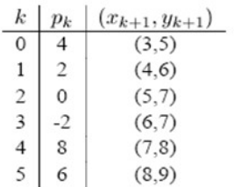
EXAMPLE: BRESENHAM’S LINE ALGORITHM
Draw a line with two endpoints (2,4) and (8,9). The line has a slope of 5/6 < 1 with:
∆x = 6, ∆y = 5.
The initial parameter has the value:
p0 = 2∆y - ∆x = 4
and the increments for calculating successive decision parameters are:
2∆y = 10 , 2∆y - 2∆x = -2
Successive pixels of the Bresenham line are listed in the following table:

Slide 36
EXERCISE (1)
Given the following endpoints p₁(0,0), p₂(8,6) of a line, find the line points that will be produced using Bresenham’s algorithm
p₁(0,0), p₂(8,6)
p₁(20,10), p₂(30,18)
p₁(21,12), p₂(29,16)

Slide 37
EXERCISE (2)
Given the endpoints p₁(0,0), p₂(-8,-4) of a line, find the line points that will be produced using Bresenham’s algorithm
Solution :
X=0 , Y=0
ΔX =-8 , ΔY=-4 ,
ΔE=2ΔY= 8
ΔNE=2ΔY-2ΔX=-8
i | P | move | x | y
1 | 0 | NE | -1 | -1
2 | -8 | E | -2 | -1
3 | 0 | NE | -3 | -2
4 | -8 | E | -4 | -2
5 | 0 | NE | -5 | -3
6 | -8 | E | -6 | -3
7 | 0 | NE | -7 | -4
8 | -8 | E | -8 | -4

Slide 38
BRESENHAM’S LINE ALGORITHM (2)
For a line with positive slope greater than 1 (|m|>1)→ we interchange the roles of the x and y directions. That is, we step along the y direction in unit steps and calculate successive x values nearest the line path.
Another way: we could revise the program to plot pixels starting from the endpoint and ending by the original start-point, after swapping the x and y values.
For negative slopes, the procedures are similar, except that now one coordinate decreases as the other increases.

Slide 39
EXAMPLE (SLOPE > 1)
Given the endpoints p₁(8,11), p₂(5,2) of a line, find the line points that will be produced using Bresenham’s algorithm
The new endpoints are: p₁(2,5), p₂(11,8)
Then, swap x and y.

Slide 40
EXAMPLE (SLOPE < 0)
Given the endpoints p₁(2,8), p₂(11,5) of a line, find the line points that will be produced using Bresenham’s algorithm
Solution :
ΔX =9 , ΔY=-3 ,
ΔE=2ΔY= 6 → (x+1, y)
ΔNE=2ΔY-2ΔX=-12 → (x+1, y-1)

Slide 41
BRESENHAM
Advantages:
  Accurate and efficient – incremental integer calculations.
  Can be adapted to draw circles and curves.
Generalization:
Increment (x or y) depending on slope (m) starting endpoints (left or right)

Slide 42
CIRCLE
Properties:
Is a set of points from a given distance of r from center position (x_{C}, y_{C} ).
Is divided into 4 quadrants and 8 octants.
Symmetrical Property of circle is used to reduce the number of calculations.

Slide 43


CIRCLE DRAWING ALGORITHM
Since the circle is a frequently used component in pictures and graphs, a procedure for generating either full circles or circular arc is included in most graphics packages.
The equation for a circle is:
where r is the radius of the circle
So, we can write a simple circle drawing algorithm by solving the equation for y at unit x intervals using:

Slide 44
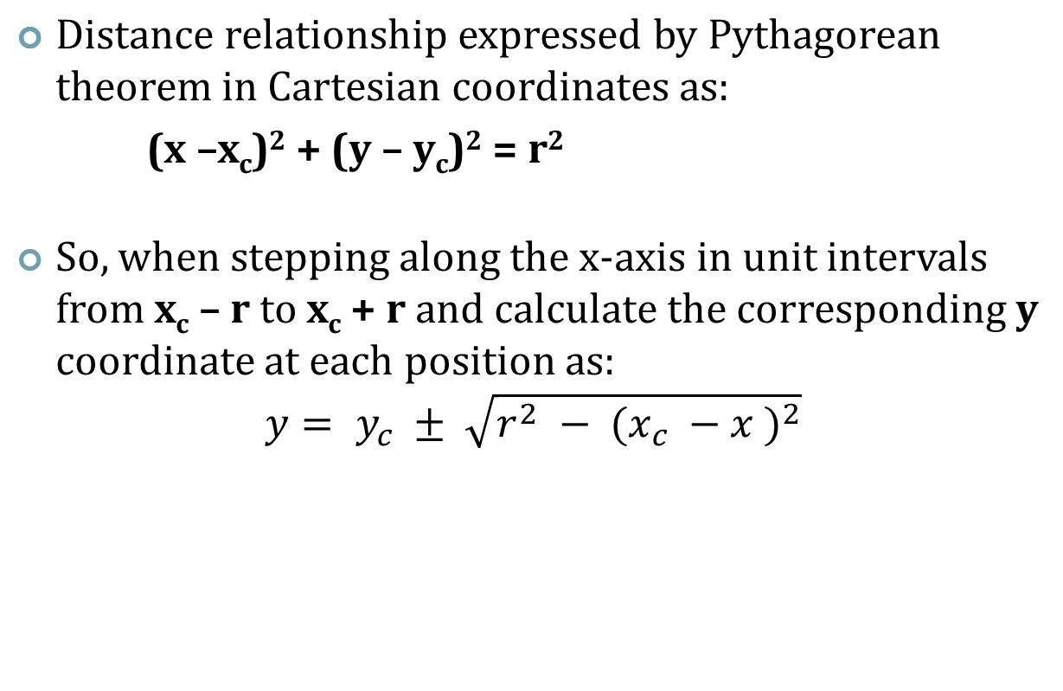
CIRCLES (SQUARE ROOT METHOD)

Slide 45
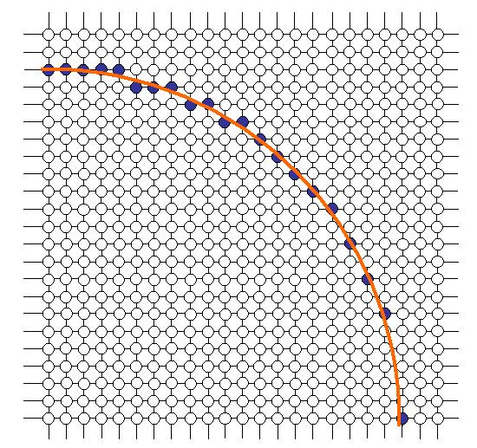





CIRCLE DRAWING ALGORITHM

Slide 46
CIRCLE DRAWING ALGORITHM
However, this is not a brilliant solution!
The resulting circle has large gaps where the slope approaches the vertical
The calculations are not very efficient
  The square (multiply) operations
  The square root operation – try really hard to avoid these!
We need a more efficient, more accurate solution

Slide 47
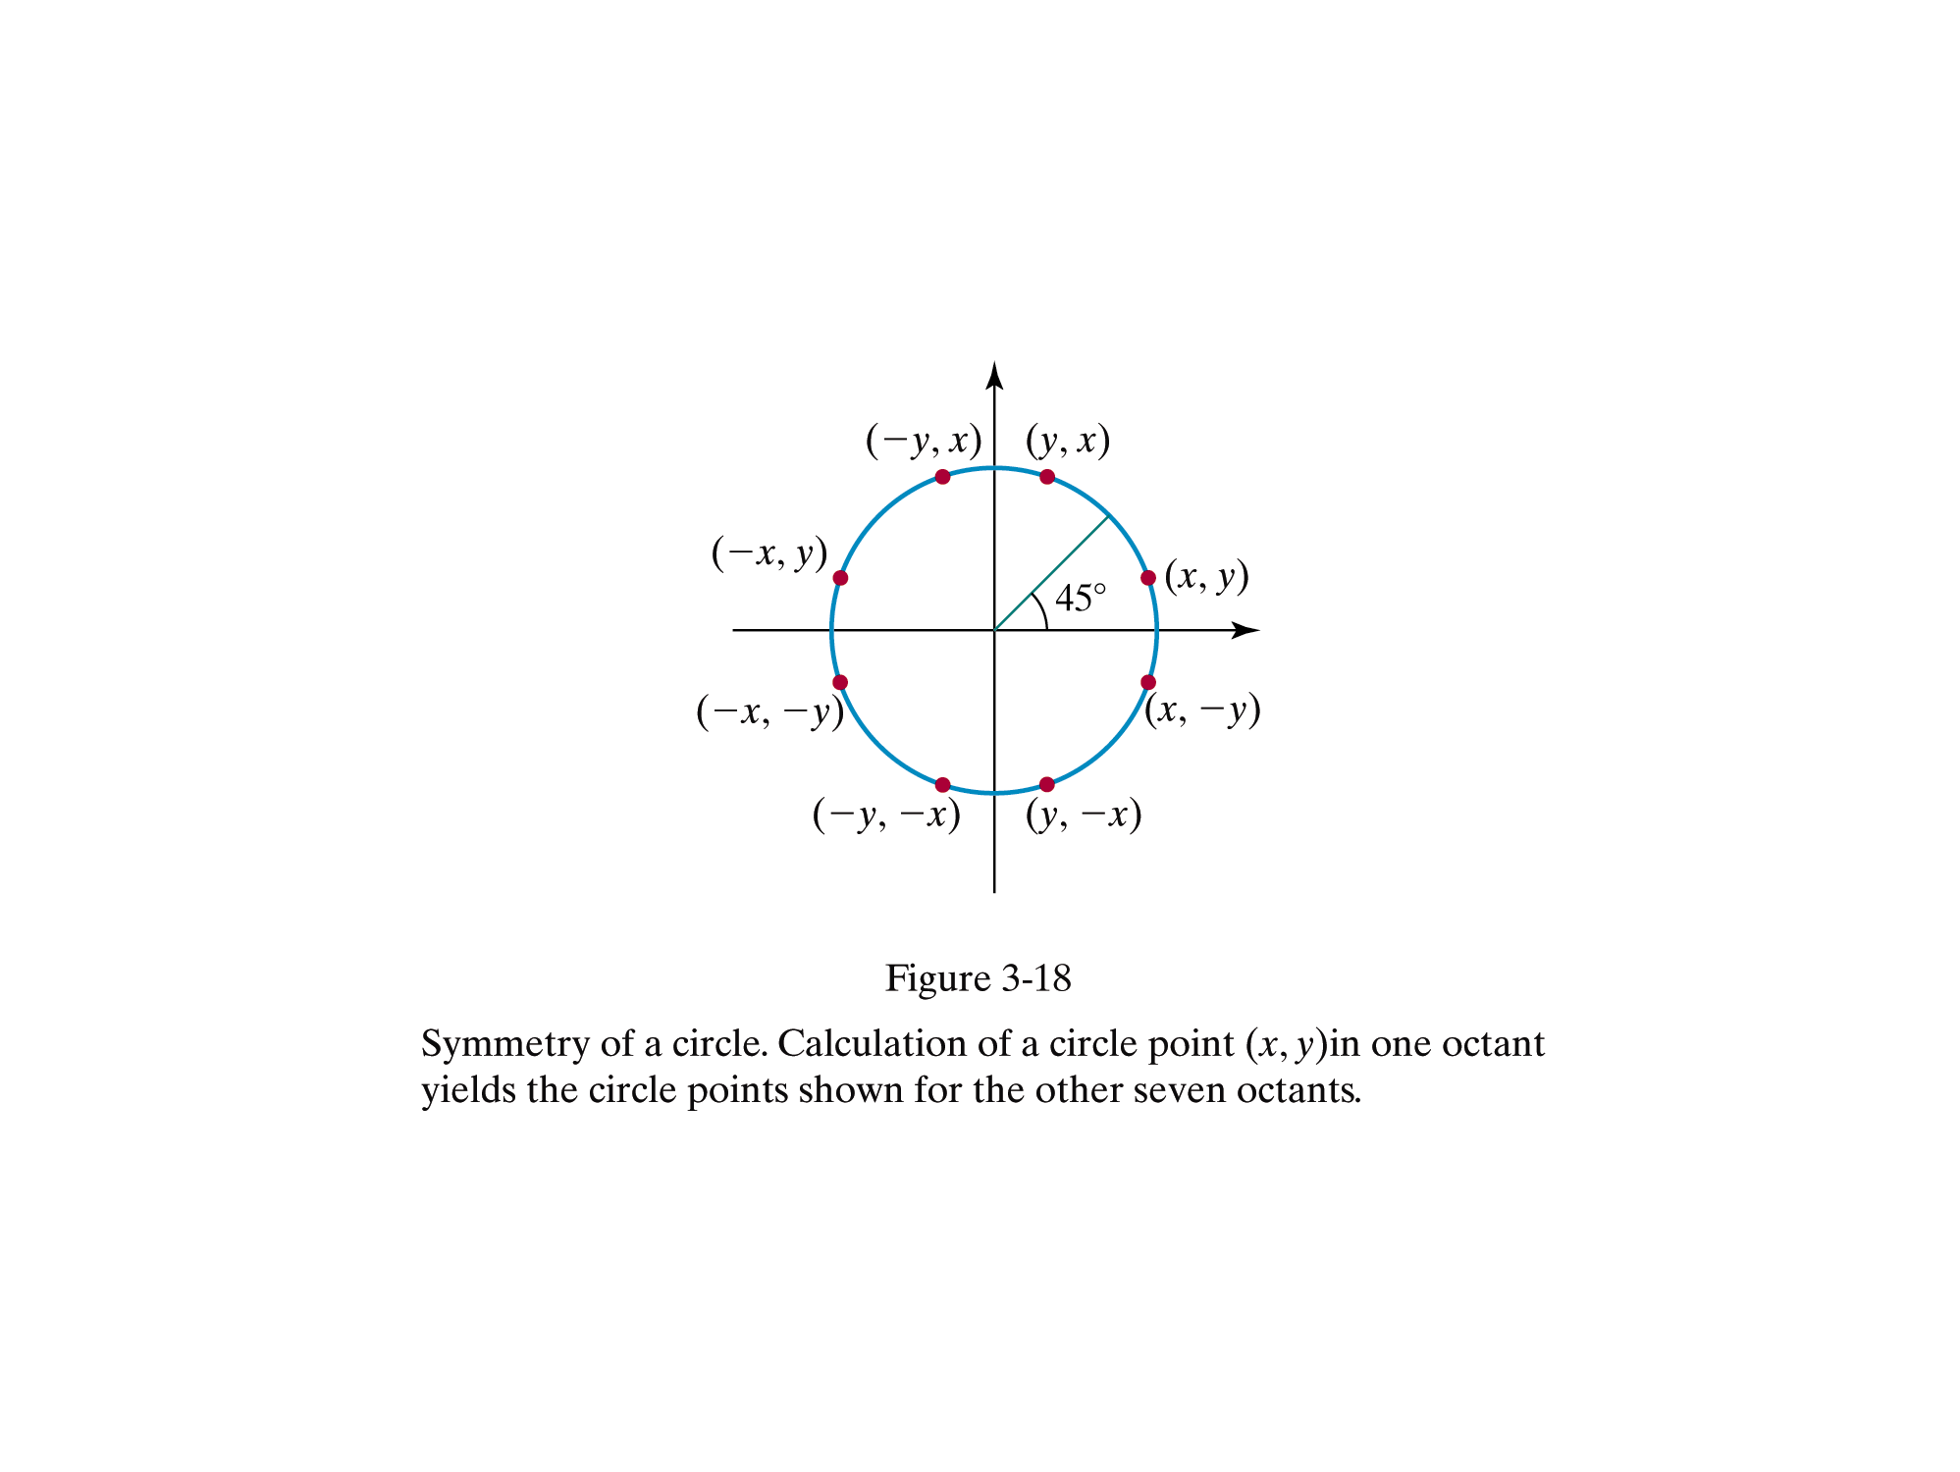

CIRCLE DRAWING ALGORITHM
The first thing we can notice to make our circle drawing algorithm more efficient is that circles centred at (0, 0) have eight-way symmetry

Slide 48
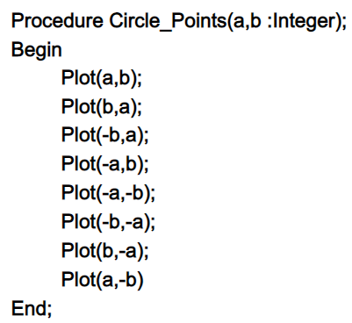
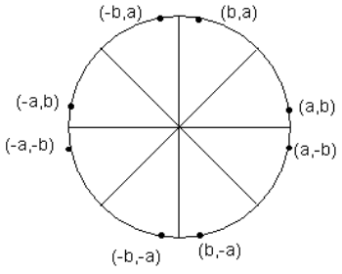
CIRCLE DRAWING BY SYMMETRY
We only need to calculate the values on the border of the circle in the first octant. The other values may be determined by symmetry. Assume a circle radius r center at (0,0).

Slide 49
CIRCLE DRAWING ALGORITHM
As in the raster line algorithm, we sample at unit intervals and determine the closest pixel position to the specified circle path at each step.
For a given radius r and screen center position (x_{c}, y_{c}), we can first set up our algorithm to calculate pixel positions around a circle path centered at the coordinate (0, 0).
Then each calculated position (x, y) is moved to its proper screen position by adding x_{c} to x and y_{c} to y.

Slide 50
CIRCLE DRAWING ALGORITHM
Along the circle section from x = 0 to x >= y in the first quadrant, the slope of the curve varies from 0 to –1. Therefore, we can take unit steps in the positive x direction over this octant and use a decision parameter to determine which of the two possible y positions is closer to the circle path at each step positions in the other seven octants are then obtained by symmetry.

Slide 51
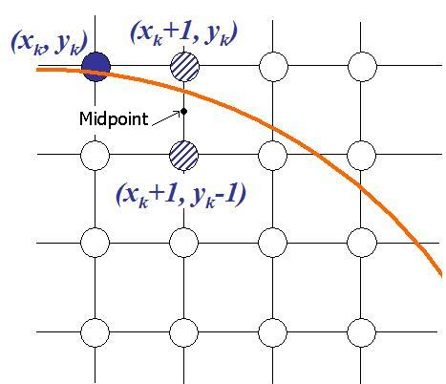
MIDPOINT CIRCLE DRAWING ALGORITHM
Assuming we have just plotted point (x_{k}, y_{k}), we next need to determine whether the pixel at position (x_{k}+1, y_{k}) or the one at position (x_{k}+1, y_{k}–1) is closer to the circle path.
The decision parameter is The circle function evaluated at the midpoint between these two pixels:

Slide 52
MIDPOINT CIRCLE DRAWING ALGORITHM
To apply the midpoint algorithm, we define a circle function:
f_{circle}(x, y) = x² + y² – r²
The relative position of any point (x, y) can be determined by checking the sign of the circle function:
< 0 If (x, y) is inside the circle boundary
f_{circle}(x, y)= = 0 If (x, y) is on the circle boundary
> 0 If (x, y) is outside the circle boundary
The circle function for the midpoints positions between pixels near the circle path is decision parameter in the midpoint algorithm, and we can set up incremental calculations for this function as we did in the line algorithm.

Slide 53
MIDPOINT CIRCLE DRAWING ALGORITHM
p_{k} = f_{circle}(x_{k} + 1,y_{k} – 1/2)
=(x_{k} + 1)² + (y_{k} – 1/2)² – r²
If p_{k} < 0 (negative), this midpoint is inside the circle and the pixel at y_{k} is closer to the circle boundary.
Increments for obtaining p_{k+1} is (2x_{k+1} + 1)
Otherwise the midpoint is outside or on the circle boundary, and we select the pixel at y_{k}–1.
Increments for obtaining p_{k+1} is (2x_{k+1} – 2y_{k+1} + 1)

Slide 54
MIDPOINT CIRCLE DRAWING ALGORITHM
The initial value of the decision parameter is obtained by evaluating the circle function at the start position (x₀, y₀) = (0, r)
P₀ = 5/4 – r
If the radius r is specified as an integer, we can simply round P₀ to
P₀ = 1 – r (for integer r)
Since all increments are integers.

Slide 55
MIDPOINT CIRCLE DRAWING ALGORITHM
For a circle centered at origin, with radius = r
x = 0, y = r
P₀=1 - r
while x < y
If P_{k} < 0
no
yes
x_{k+1} = x_{k}+1
y_{k+1} = y_{k}-1
P_{k+1} = P_{k} +2(x_{k+1} - y_{k+1} ) +1
x_{k+1} = x_{k}+1
P_{k+1} = P_{k} +2(x_{k+1} )+1

Slide 56
MIDPOINT CIRCLE DRAWING ALGORITHM
Next:
Determine symmetry points in the other seven octants
Move each calculated pixel position (x, y) onto the circular path centred at (xc, yc) and plot the coordinate values:
X= x+ xc
y = y+ yc

Slide 57
EXAMPLE (1)
Given a circle radius=10, we demonstrate the midpoint circle algorithm by determining positions along the circle octant in the first quadrant from x = 0 to x = y.
Solution :
P₀ = 1 – r = – 9
(x₀, y₀) = (0, 10)
2x₀ = 0 and 2y₀= 20

Slide 58
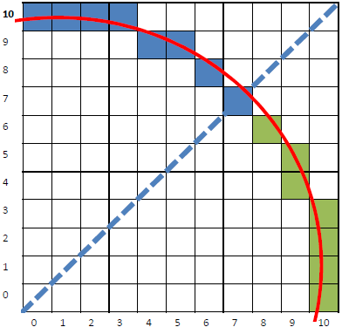
EXAMPLE (1)
k | P_{k} | point | 2x_{k+1} | 2y_{k+1}
0 | -9 | (1, 10) | 2 | 20
1 | -6 | (2, 10) | 4 | 20
2 | -1 | (3, 10) | 6 | 20
3 | 6 | (4, 9) | 8 | 18
4 | -3 | (5, 9) | 10 | 18
5 | 8 | (6, 8) | 12 | 16
6 | 5 | (7, 7) | 14 | 14
A plot of the generated pixel positions in the first quadrant is shown in the figure

Slide 59
EXAMPLE (1)
point | The rest points
(1, 10) | (-1,10),(1,-10),(-1,-10), (10,1), (-10,1),(10,-1),(-10,-1)
(2, 10) | (-2,10),(2,-10),(-2,-10), (10,2), (-10,2),(10,-2),(-10,-2)
(3, 10) | (-3,10),(3,-10),(-3,-10), (10,3), (-10,3),(10,-3),(-10,-3)
(4, 9) | (-4,9),(4,-9),(-4,-9), (9,4), (-9,4),(9,-4),(-9,-4)
(5, 9) | (-5,9),(5,-9),(-5,-9), (9,5), (-9,5),(9,-5),(-9,-5)
(6, 8) | (-6,8),(6,-8),(-6,-8), (8,6), (-8,6),(8,-6),(-8,-6)
(7, 7) | (-7,7),(7,-7),(-7,-7)

Slide 60
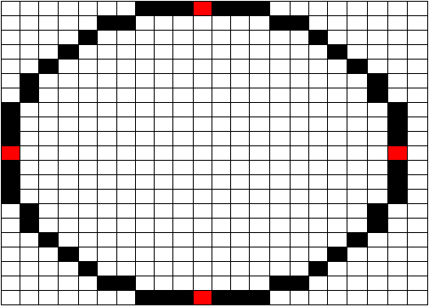
EXAMPLE (1)

Slide 61
EXERCISE
Given a circle with centre c and radius r as following. What positions should be generated using Midpoint algorithm.
c= (-2,4) and r = 6.
c= (5,6) and r = 4.

Slide 62
BRESENHAM’S CIRCLE DRAWING ALGORITHM
For a circle centered at origin, with radius = r
x = 0, y = r
P₀=3 - 2r
while x < y
If P_{k} < 0
no
yes
x_{k+1} = x_{k}+1
y_{k+1} = y_{k}-1
P_{k+1} = P_{k} +4(x_{k+1} - y_{k+1} ) +10
x_{k+1} = x_{k}+1
P_{k+1} = P_{k} +4(x_{k+1} )+6

Slide 63
BRESENHAM’S CIRCLE DRAWING ALGORITHM
Next:
Determine symmetry points in the other seven octants
Move each calculated pixel position (x, y) onto the circular path centred at (xc, yc) and plot the coordinate values:
X= x+ xc
y = y+ yc

Slide 64
EXERCISE
Given a circle with centre c and radius r as following. What positions should be generated using Bresenham’s algorithm.
c= (0,0) and r = 10.
c= (5,6) and r = 4.

Slide 65
End of Chapter

